Slide 1

Chapter 9 – part II

Slide 2
OUTLINE
  Energy in rotational motion.
  Moment of inertia.
  Calculations.

Slide 3
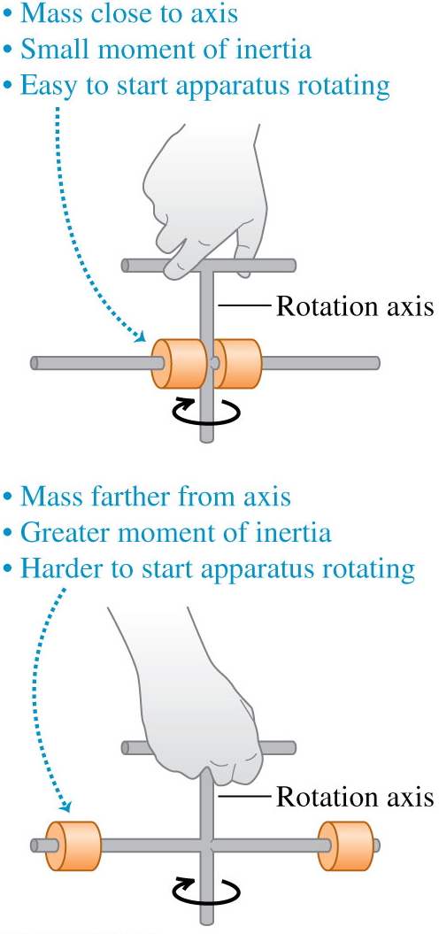
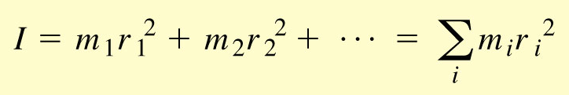

Rotational kinetic energy
The moment of inertia of a set of particles is
The rotational kinetic energy of a rigid body having a moment of inertia I is

Slide 4
Problem #1
Two blocks with masses 10 kg and 15 kg are clamped at the ends of a rod of length
2 m and negligible mass. Find the moment of inertia of this system about an axis
perpendicular to the rod and passing through:
the center of the rod;
a point one-forth of the length from the end with 15 kg block.

Slide 5
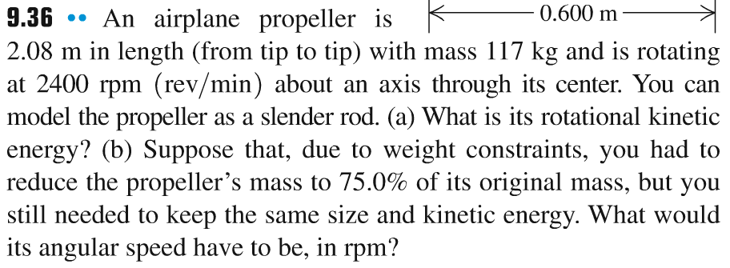
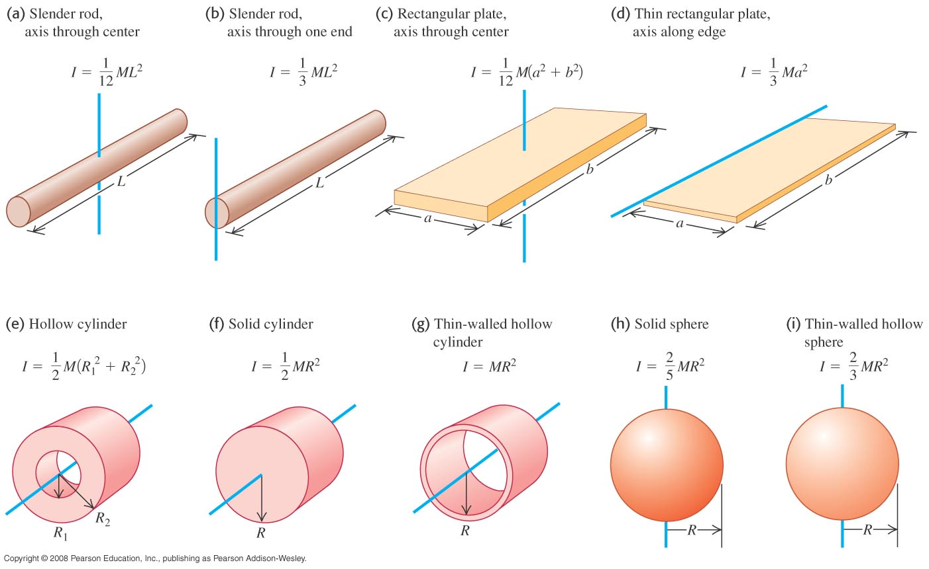
Problem #2

Slide 6
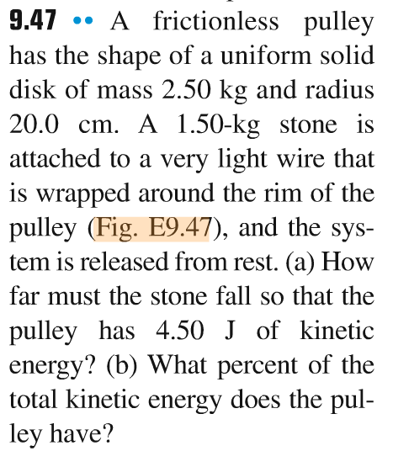
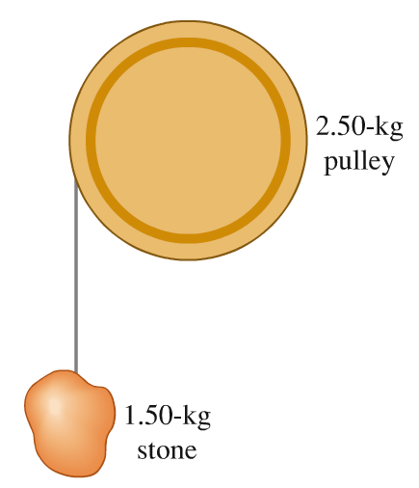
Problem #3

Slide 7
Gravitational potential energy of an extended body
The gravitational potential energy of an extended body is the same as if all the mass were concentrated at its center of mass: U_{grav} = Mgy_{cm}.

Slide 8
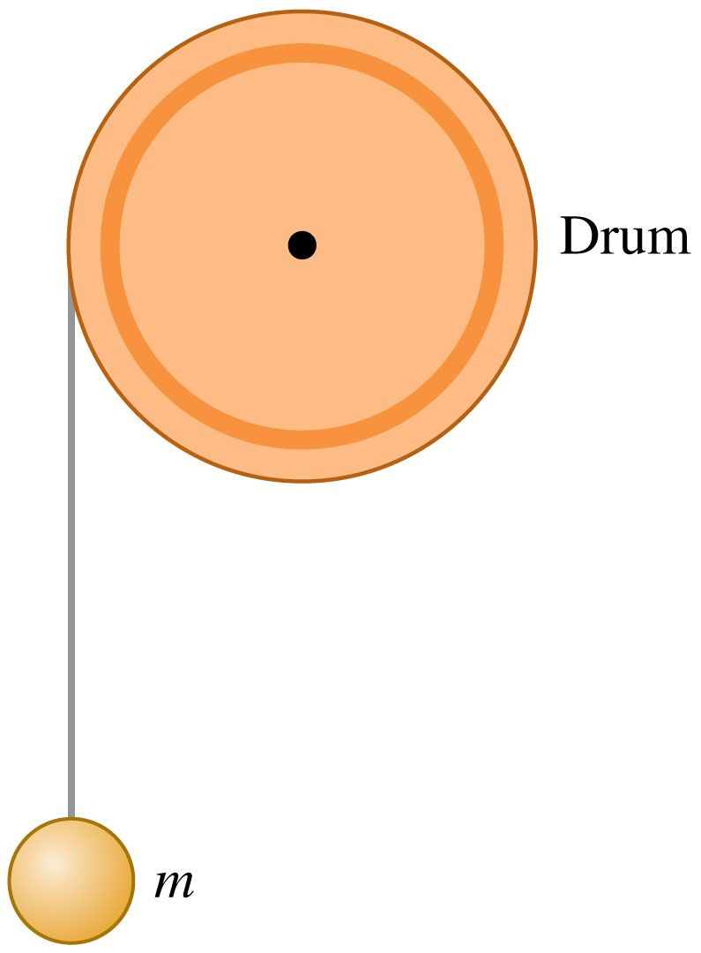
A thin, very light wire is wrapped around a drum that is free to rotate. The free end of the wire is attached to a ball of mass m. The drum has the same mass m. Its radius is R and its moment of inertia is I = (1/2)mR². As the ball falls, the drum spins.
At an instant that the ball has translational kinetic energy K, the drum has rotational kinetic energy of…?

Slide 9
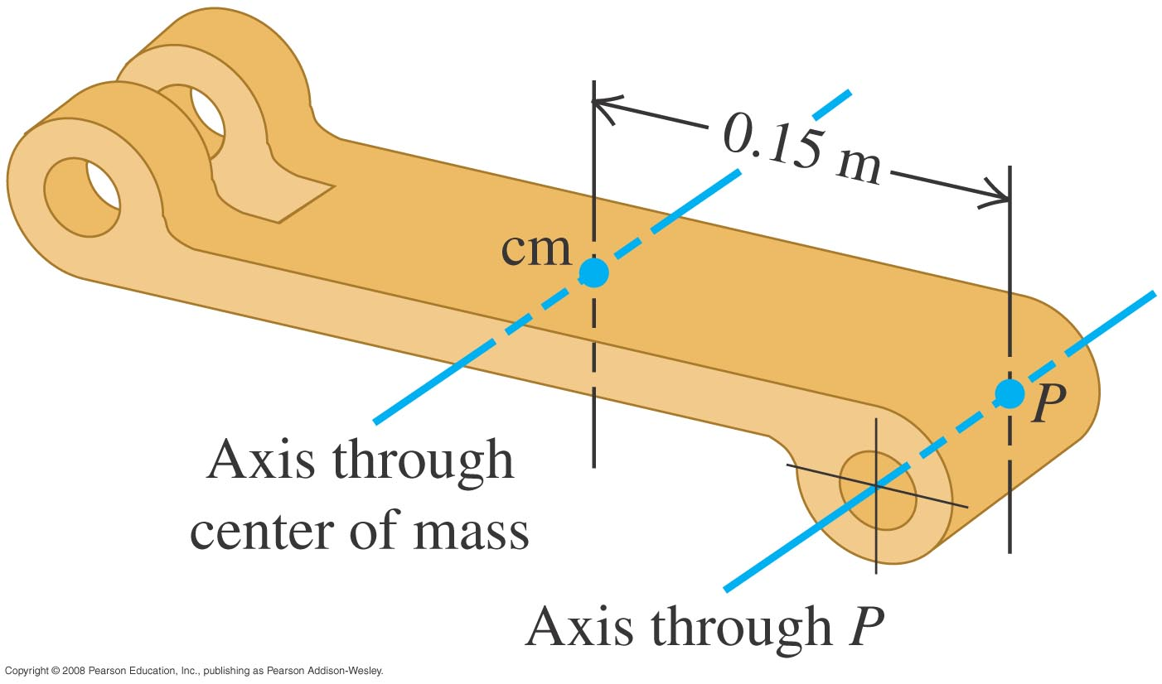
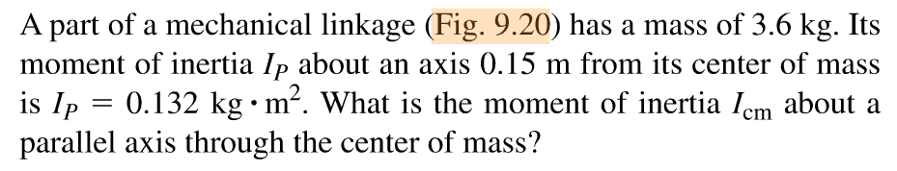
The parallel-axis theorem
The parallel-axis theorem is: I_{P} = I_{cm} + Md²

Slide 10
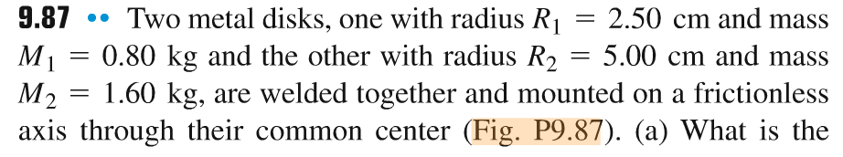
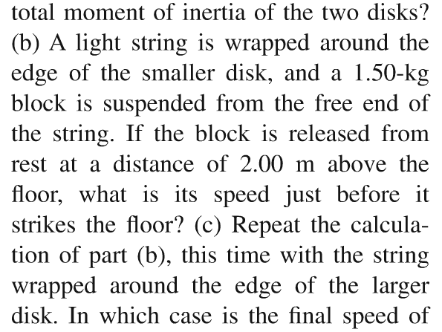
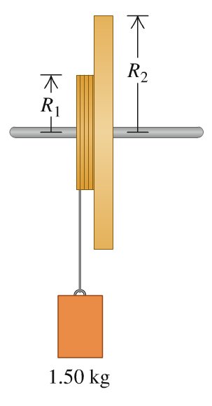
Problem #4

Slide 11
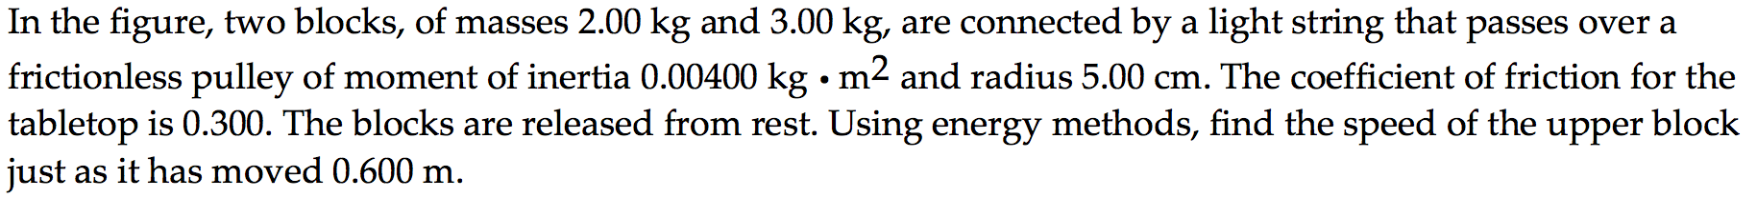
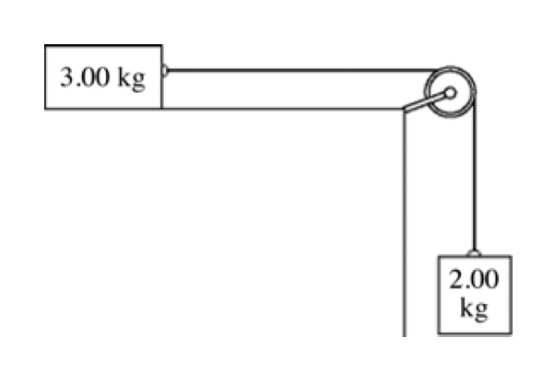
Problem #5

